Slide 1
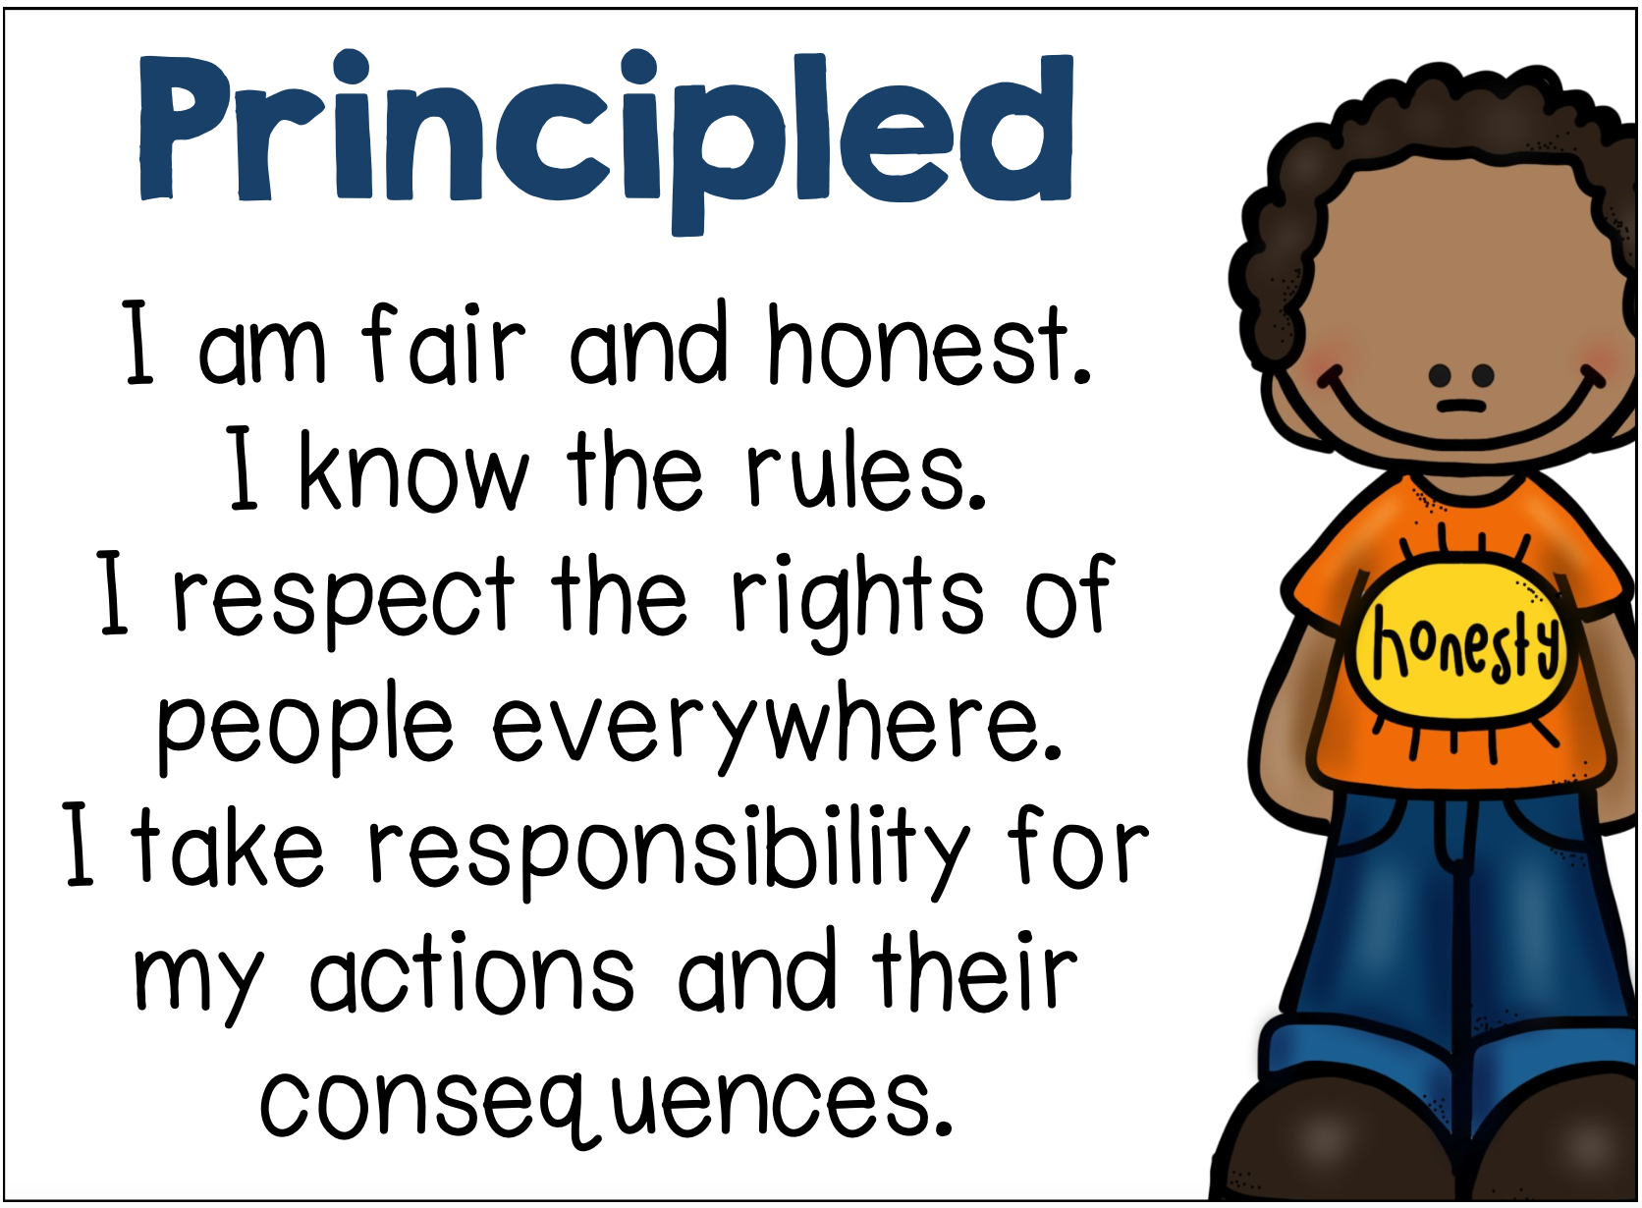
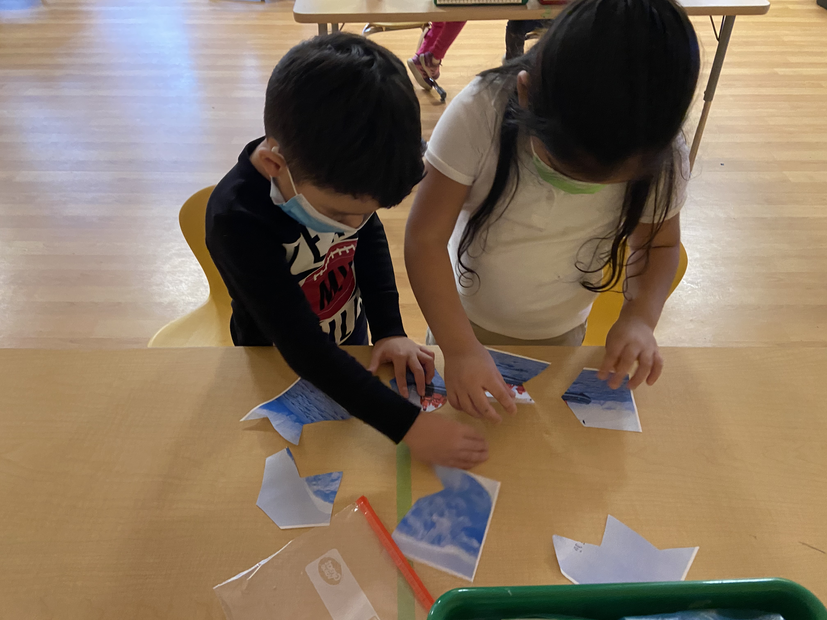
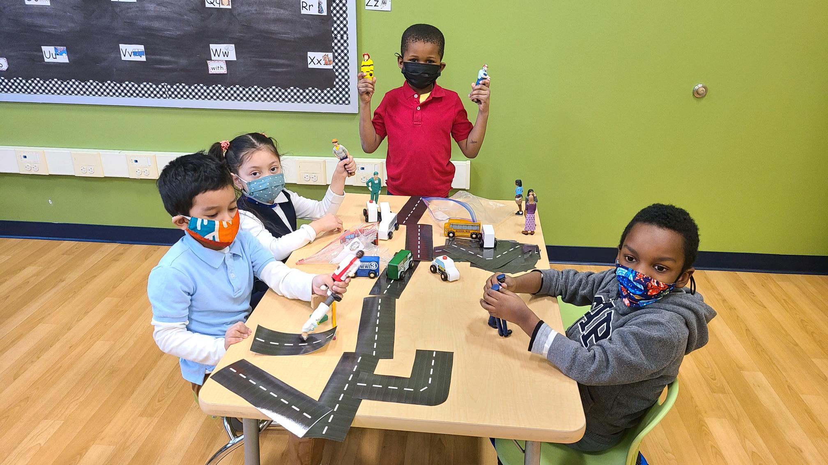
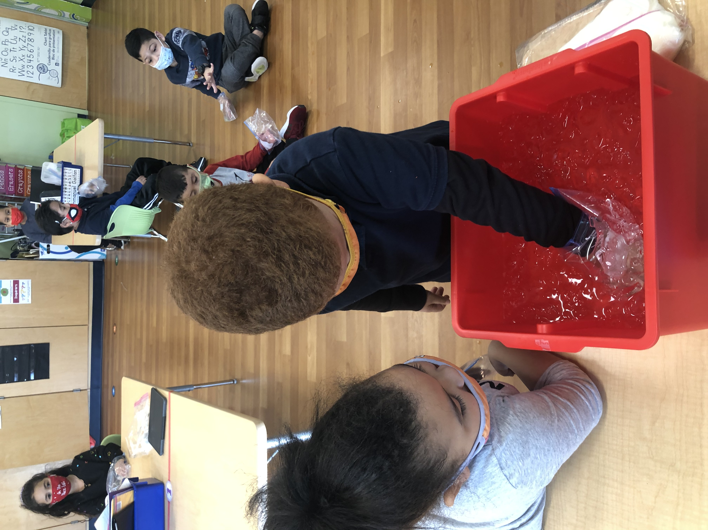
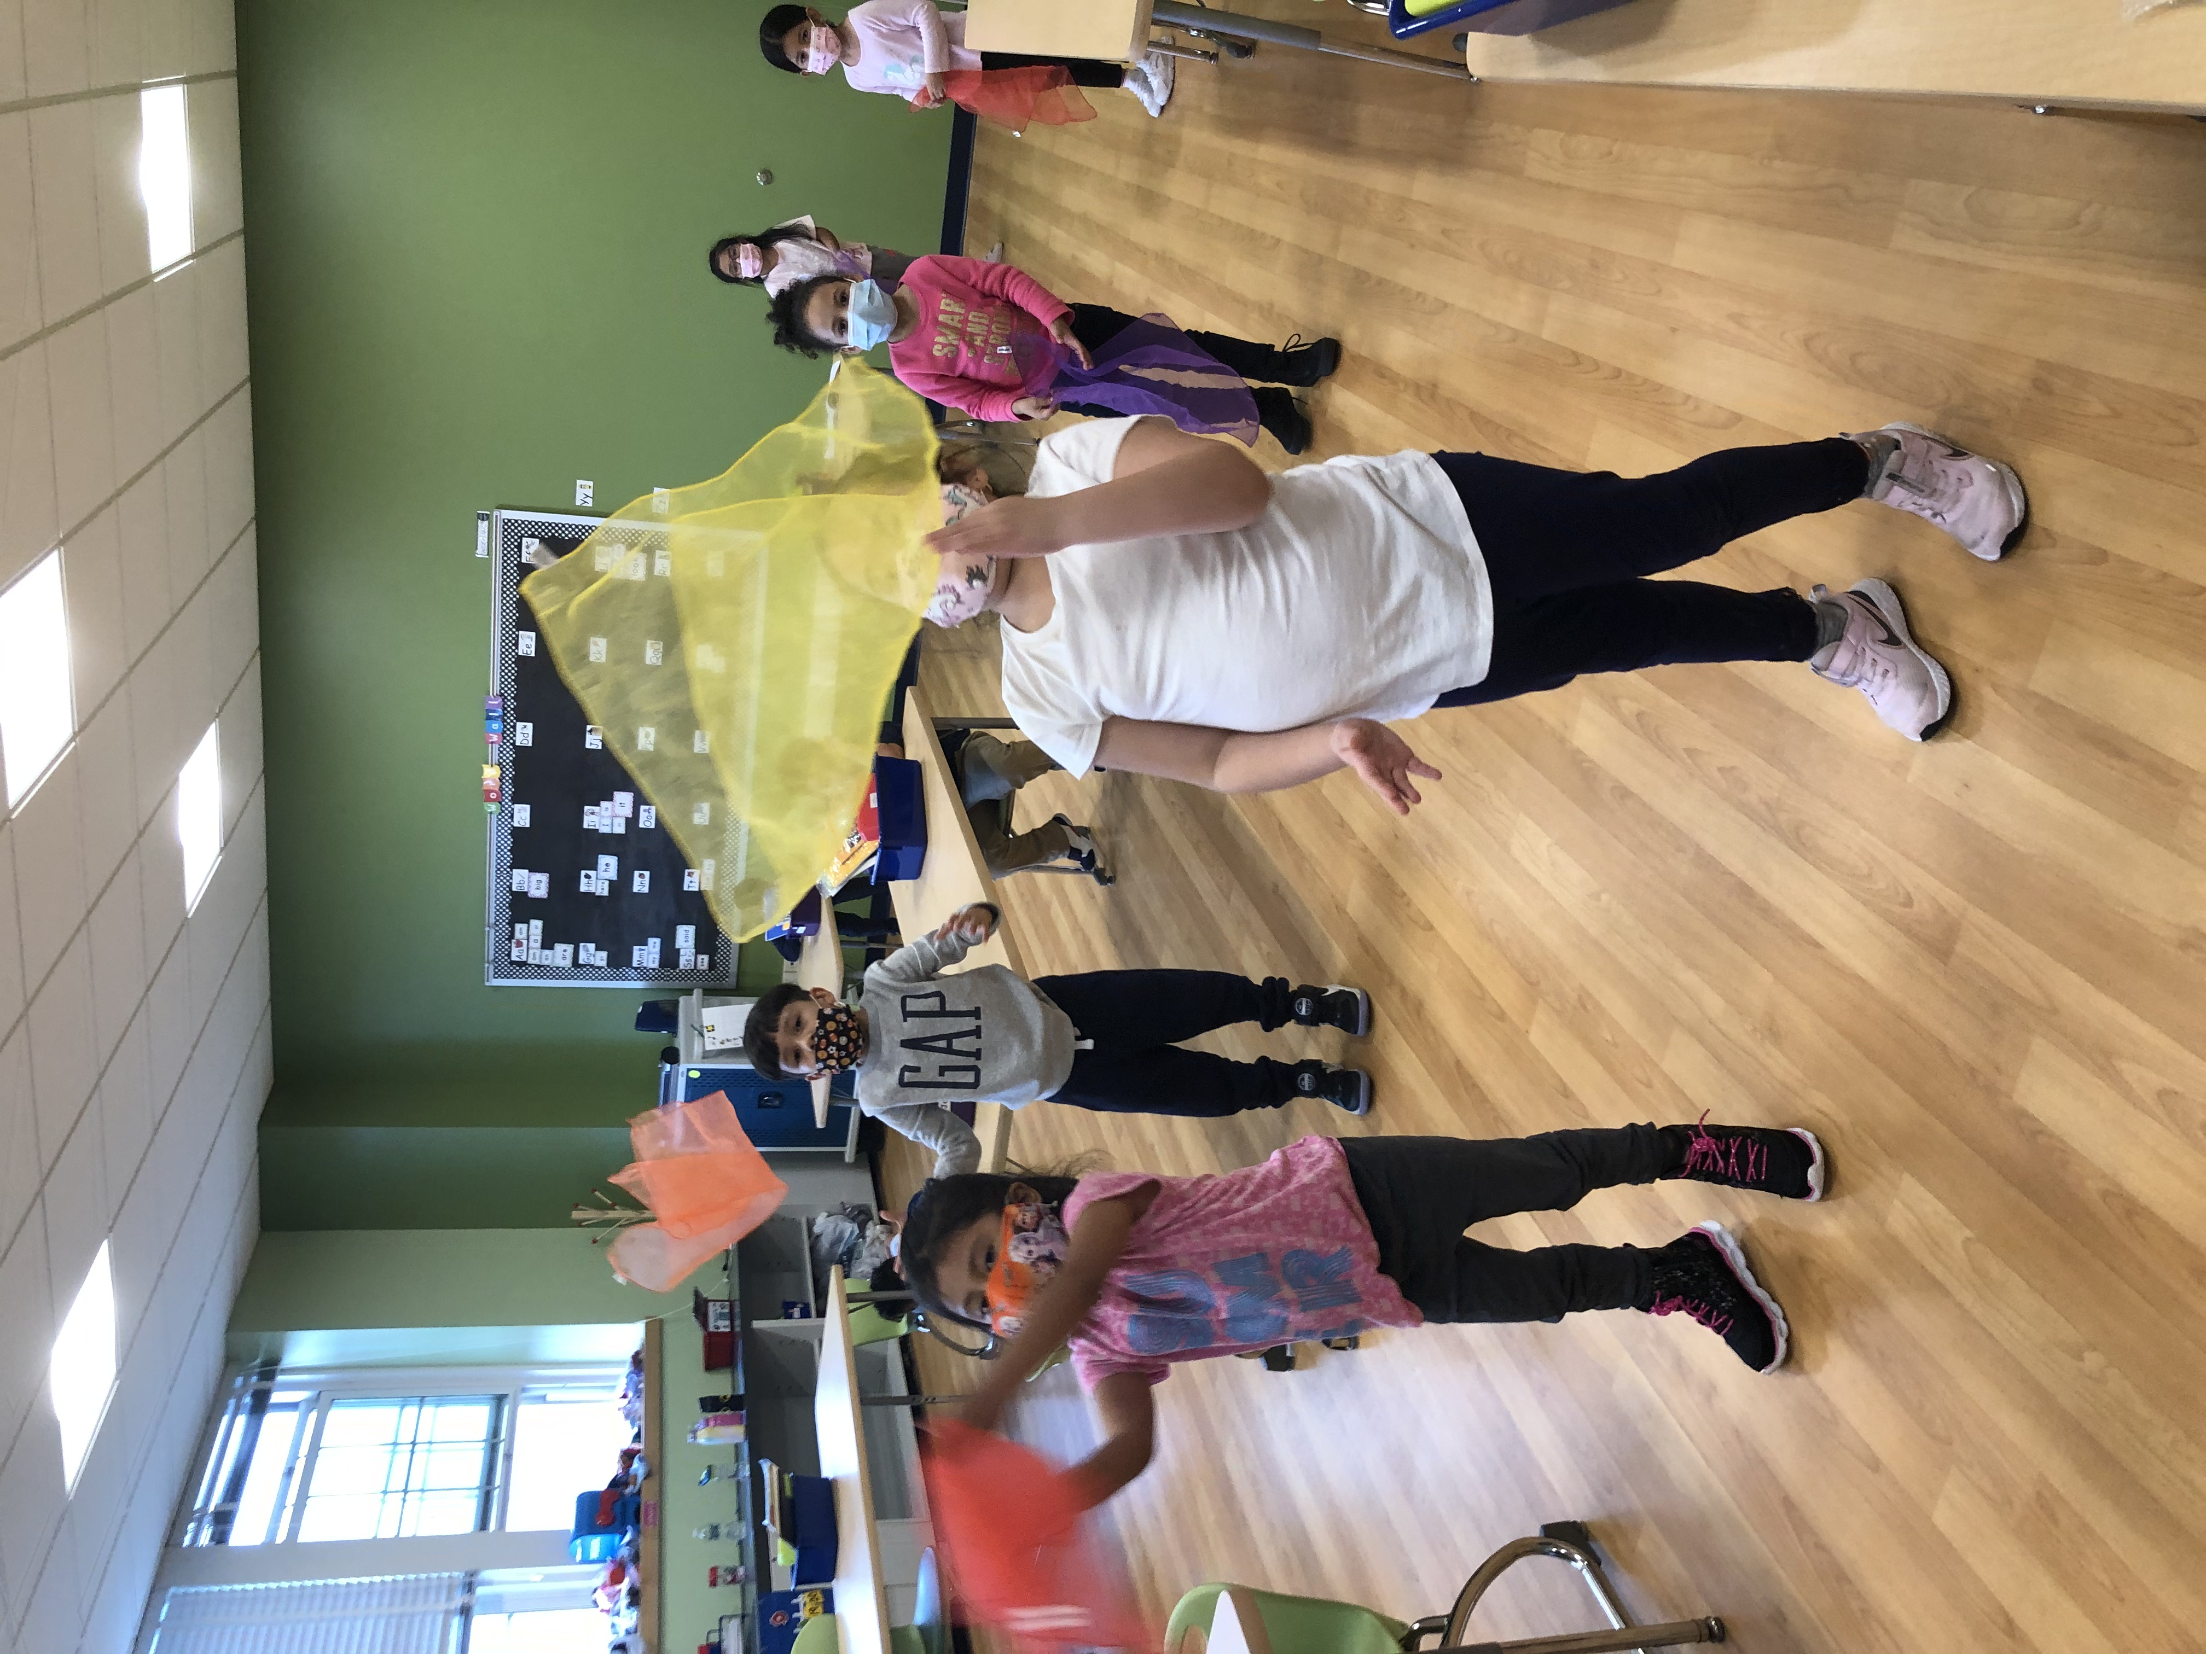
Prospect School’s Verification Visit to become an IB World School will take place on Monday, March 22nd and Tuesday, March 23rd. The virtual visit will review the instructional practices we have established as an IB PYP Candidate School and confirm they are aligned with the IB PYP philosophy. The visiting team will visit classes virtually, meet with students, parents, teaching staff and the governing body of the Hempstead Public School District.
March’s Learner Profile Attribute is Principled
Help your child at home by playing games that involve teams. Involve them in deciding on the rules for the game or activity. Discuss the qualities of being honest and a team player. Praise your child when they are honest are admit to making a mistake.

Slide 2
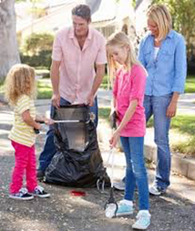
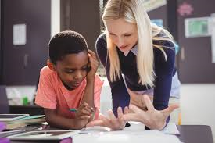
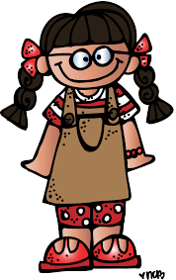
March - Learner Profile Principled
Students who are principled have a sense of fairness and are honest with themselves and with others. They understand that sometimes there are rules, and they follow them. They have an understanding of moral reasoning.
How can parents help to develop students who are principled at home?
Involve your child in deciding on the rules for a game or activity and then ensure that they stick to the ones that have been decided upon.
Encourage your child to play games that involve teams. Discuss with your child the qualities of a team player. What sort of person would they want on their team?
When your child wins a game insist that he or she is a well-mannered winner. They might thank their opponent or shake hands with them if it’s appropriate.
When playing a game, don’t change the rules or let your child win. Being a gracious loser is just as important as being a good winner. ☺

Slide 3
Marzo: Perfil del Alumno De principios
Estudiantes que son de principios tienen un sentido de justicia y son honestos consigo mismos y con los demás. Entienden que a veces hay reglas y las siguen. Tienen una comprensión del razonamiento moral.
¿Cómo pueden los padres ayudar a desarrollar estudiantes que tengan principios en casa?
Haga que su hijo participe en la decisión de las reglas de un juego o actividad y luego asegúrese de que se adhieran a las que se han decidido.
Anime a su hijo a jugar juegos que involucren equipos. Hable con su hijo sobre las cualidades de un jugador de equipo. ¿Qué tipo de persona querrían en su equipo?
Cuando su hijo gane un juego, insista en que es un ganador educado. Podrían agradecer a su oponente o darle la mano si es apropiado.
Cuando juegue, no cambie las reglas ni deje que su hijo gane. Ser un buen perdedor es tan importante como ser un buen ganador.☺

